Slide 1
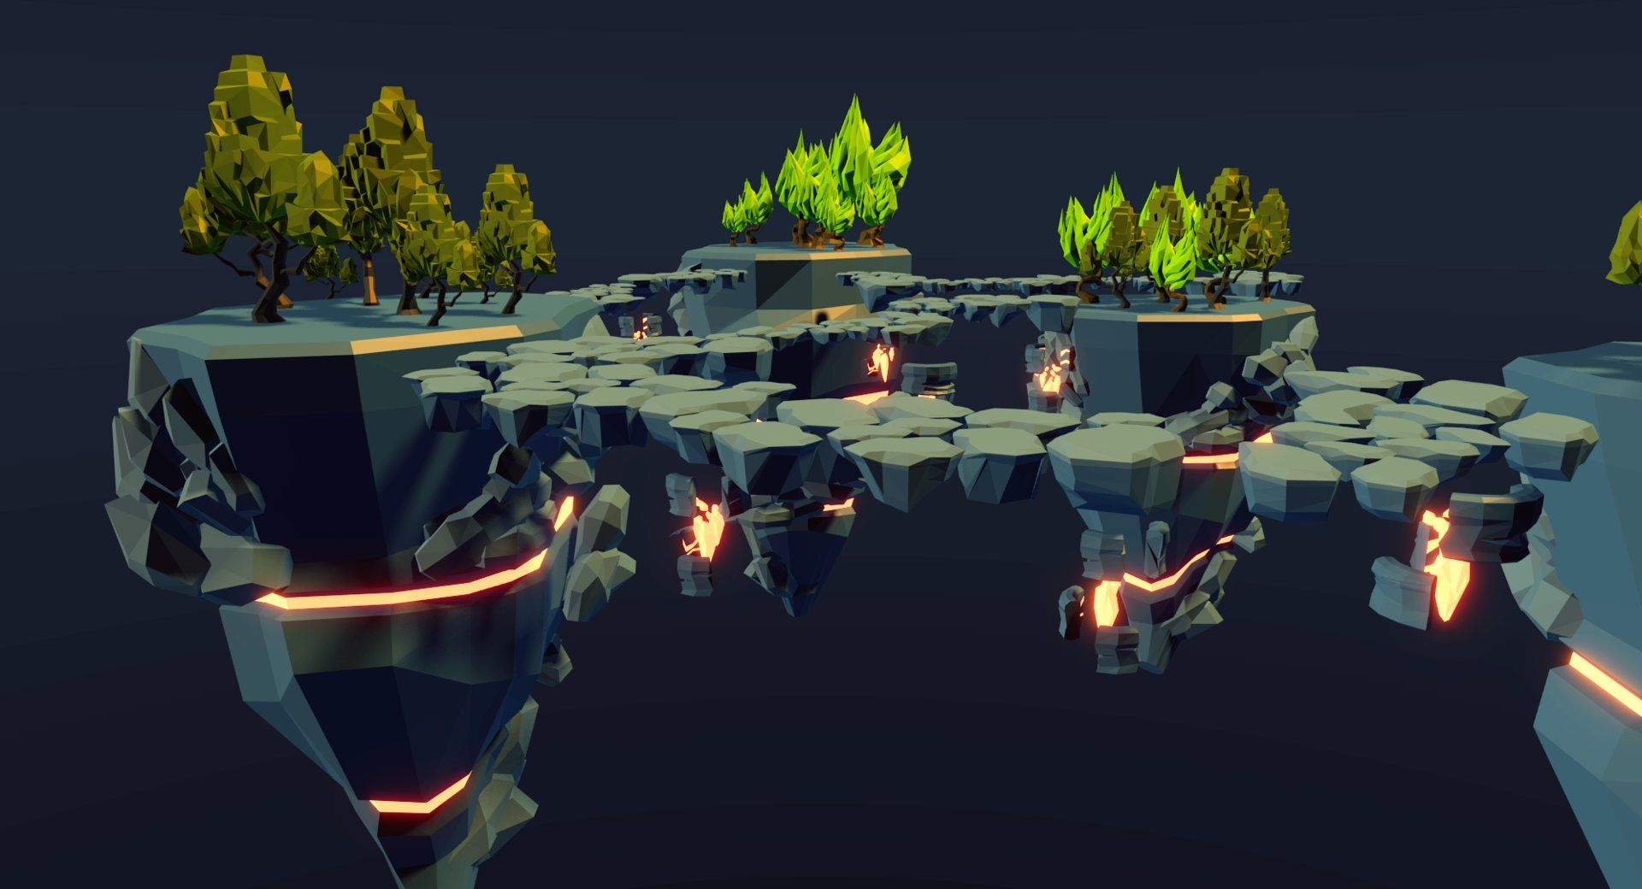
Game design

Slide 2

What Game Design is
Game design can be considered the planning arm of the entire process for making a video game. No video game gets made without a plan, and video game design is, more or less, the process of making that plan. The field is somewhat a hybridization of creativity and technical skills that combine into a cohesive, fleshed-out idea that people can work with using concrete and actionable tasks.
However, that is a lot to unpack, so let’s break everything down a bit more in layman’s terms.

Slide 3

Creative Side
As mentioned, all video games start with an idea. This idea can simply be something like:
“I want to make a platformer where the princess is the player character.”
“I will make a choice-based story RPG set in a Lovecraftian-inspired world.”
“I think it’d be cool if there was a one-hit kill battle royale video game.”

Slide 4

What the idea is doesn’t particularly matter, but the point is that these are the sparks that kickstart the game design. From there, though, this idea is not enough yet to make a video game. Instead, we’re left with a lot of questions:
What does the princess player character look like?
How are “choices” presented in the video game – dialogue or implemented in the gameplay itself?
How can a one-hit kill video game be balanced for fun rather than frustration – and is it multiplayer or singleplayer?
What sorts of weapons and/or items are available in these video games?
Do these video games have some deeper story?

Slide 5

We can certainly go on and on with these questions, yet what you may not realize is answering these questions is a large part of what game design is about! These are the exact elements that help you design the game – from the characters and plot, to the design of the levels, to the mechanics of how the video game is played, to the expression of the mechanics in a way that is fun, and even to aesthetics. Every little aspect like this must be answered, and game designers are the ones to do just that!

Slide 6
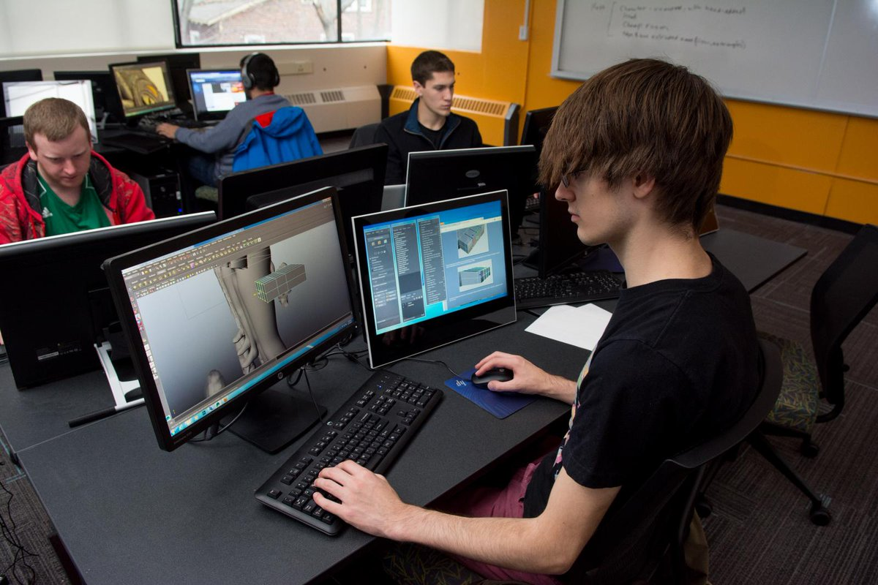
Game Design as a Career
Now that we understand what game design is, let’s dive into the actual practice of it as a career in the gaming industry. Even if you’re only interested in video games as a hobby, this still may be a worthwhile section to explore just to get an understanding of a game designer’s everyday life – as game design is not all fun and playing games. It may also give you some insight into what awaits you should you make that critical decision to start this career path.

Slide 7

Script/story writing
If a story is involved with the game, a game designer might spend a lot of time working on those aspects. This includes establishing the setting and history, establishing characters and their backstories, planning out the narrative plot, and potentially writing all the dialogue that will be used throughout the game. In larger teams, the game designer may simply coordinate with dedicated writers to get some or all of these various aspects done. Nevertheless, a game designer will often be intimately involved in getting the story off the ground.

Slide 8
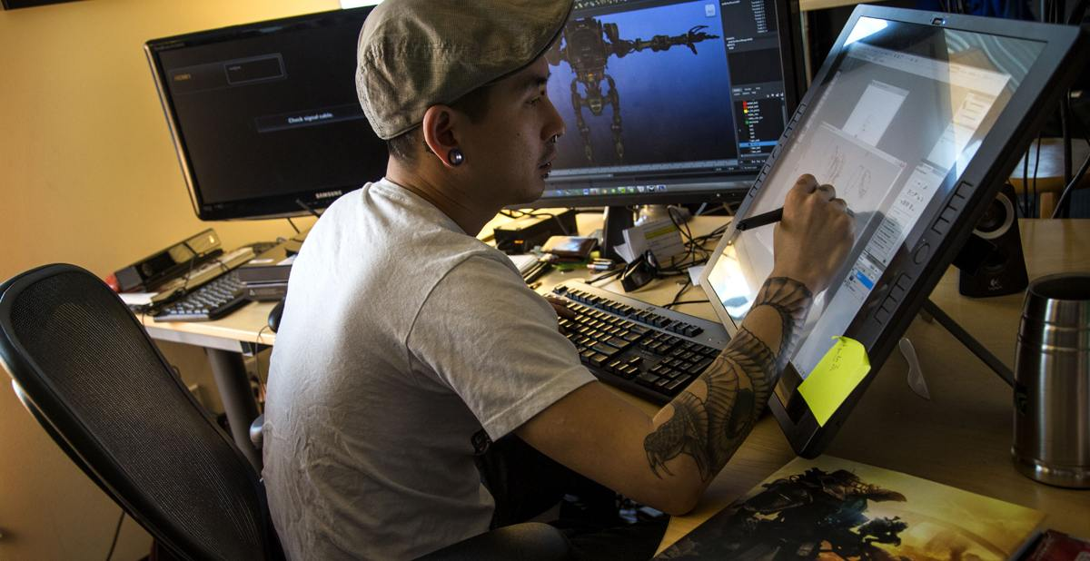
Planning and creating game art
Part of a game designer’s duties is to decide the game’s aesthetics. This can include creating basic character designs, environment visual designs, and so forth. Technical decisions will also be made here, such as whether to do pixel-art, 3D graphics, etc. Now in some cases, a game designer will make a basic concept, which they then turn over to a professional game artist to flesh out into a usable piece for relay to asset creators. In other cases, the game designer’s own art may serve as the final concept art from which the game assets are made.

Slide 9
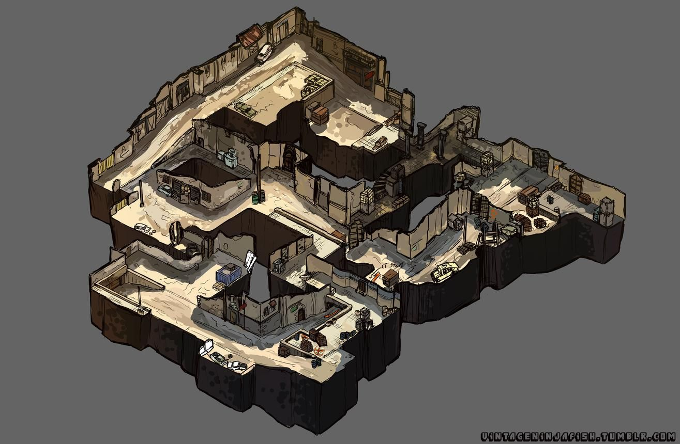
Designing levels/puzzles/challenges
One thing almost all video games have in common is that there are “levels” – i.e. spaces where the game is played. Even if a single-level game – for example, a fighting game stage – every block, aesthetic, and critical path will be planned out by the game designer. This can also include planning out battle
encounters, puzzles, and similar should the specific game call for that. Besides planning, a game designer may also be one of the main members implementing the levels into the game by placing assets and so forth – allowing them to tweak things as they go to create the best game possible.

Slide 10
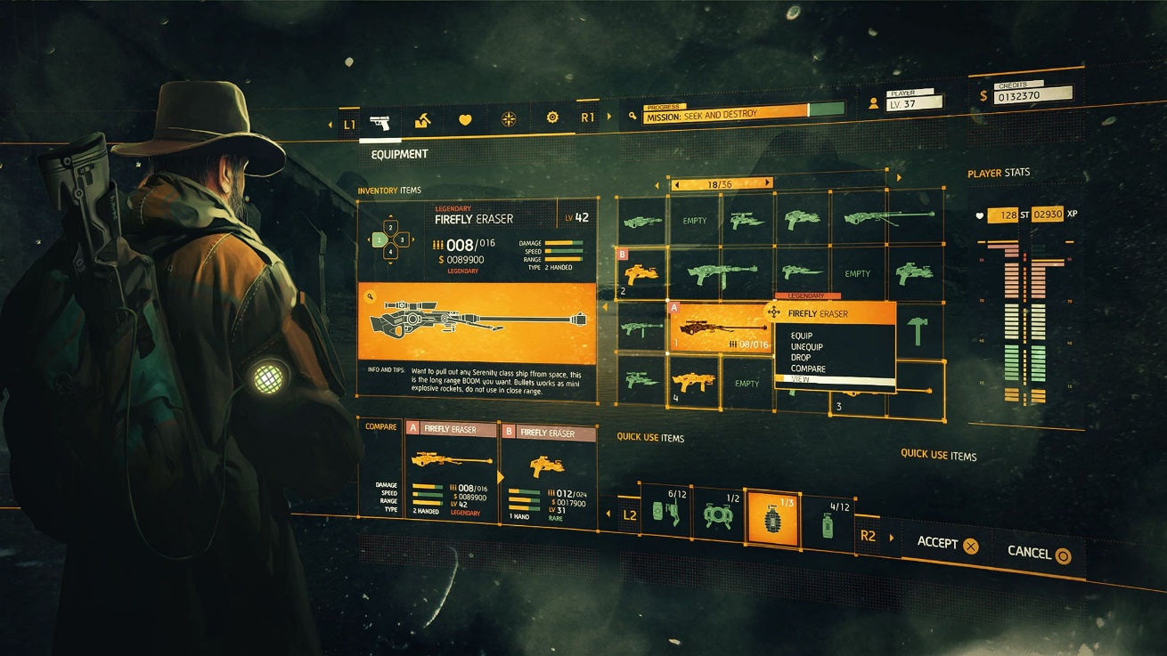
Planning interfaces
If there is no dedicated UI/UX designer on the team, guess what falls to the game designer? Whether an inventory screen, some sort of video game encyclopedia, health and hunger bars, or even simply a text score, all these interfaces need to be planned to exist, placed strategically, and have their aesthetic design decided on. Game designers will spend a huge amount of time designing this aspect, as it is one of the main ways players interact and receive information from a video game.

Slide 11
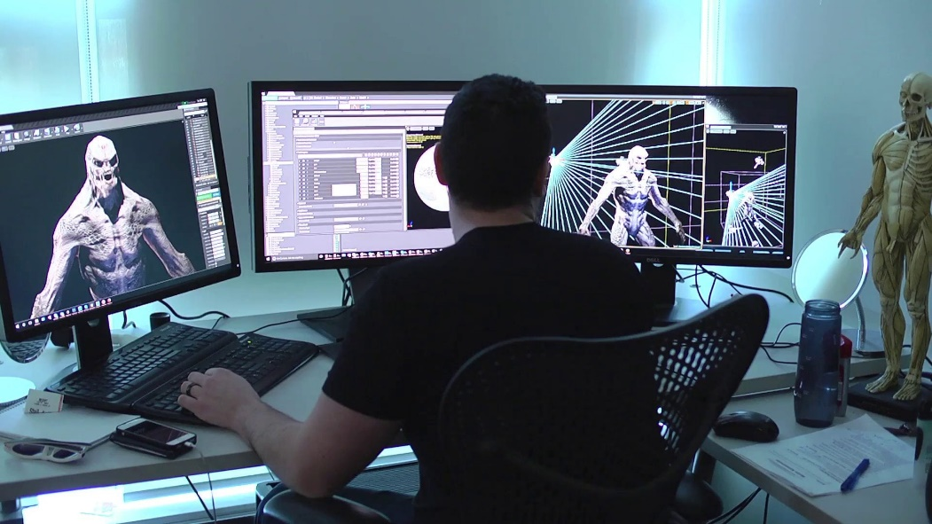
Developing gameplay
As mentioned earlier, one of the main things video game designers do, even more so than the activities above, is decide on the exact mechanics of the game and how it is played. Even if it’s just how fast a player character jumps, a game designer will serve a critical role in deciding these aspects. This process usually begins with a game designer writing a Game Design Document so everything is laid out, whether for just them or for a larger team. From there, a game designer will tweak the design further so every minute detail presents well and feels good as a player plays through the game.

Slide 12

Programming
Once again, this activity depends entirely on the situation. However, many game designers do participate at least somewhat in the programming activities of the video game. This can range from very literally doing it themselves, to simply helping out other programmers and overseeing certain technical aspects so it is a match for what the designer intended. At the very least, some programming knowledge is helpful even if you don’t do it, since some aspects of game design are reliant on the technical limitations.

Slide 13
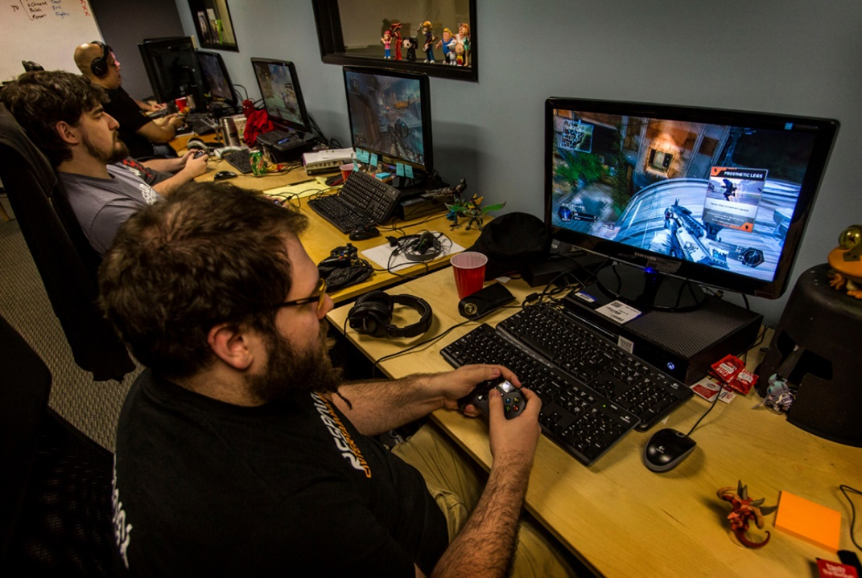
Testing and changing
Finally, and a big one for video game designers, is testing and changing the video game they’re working on. Besides being fun, video games at their heart are supposed to have a consistent, quality experience. Game designers will spend a long time testing every aspect of the video game to test how it feels to play, whether there are any mechanics that are broken or ruin the competitive nature of the video game, and so forth. Once those issues are discovered, they help tweak the game design until the final video game product is the very best it can be as far as the core design goes.

